Slide 1

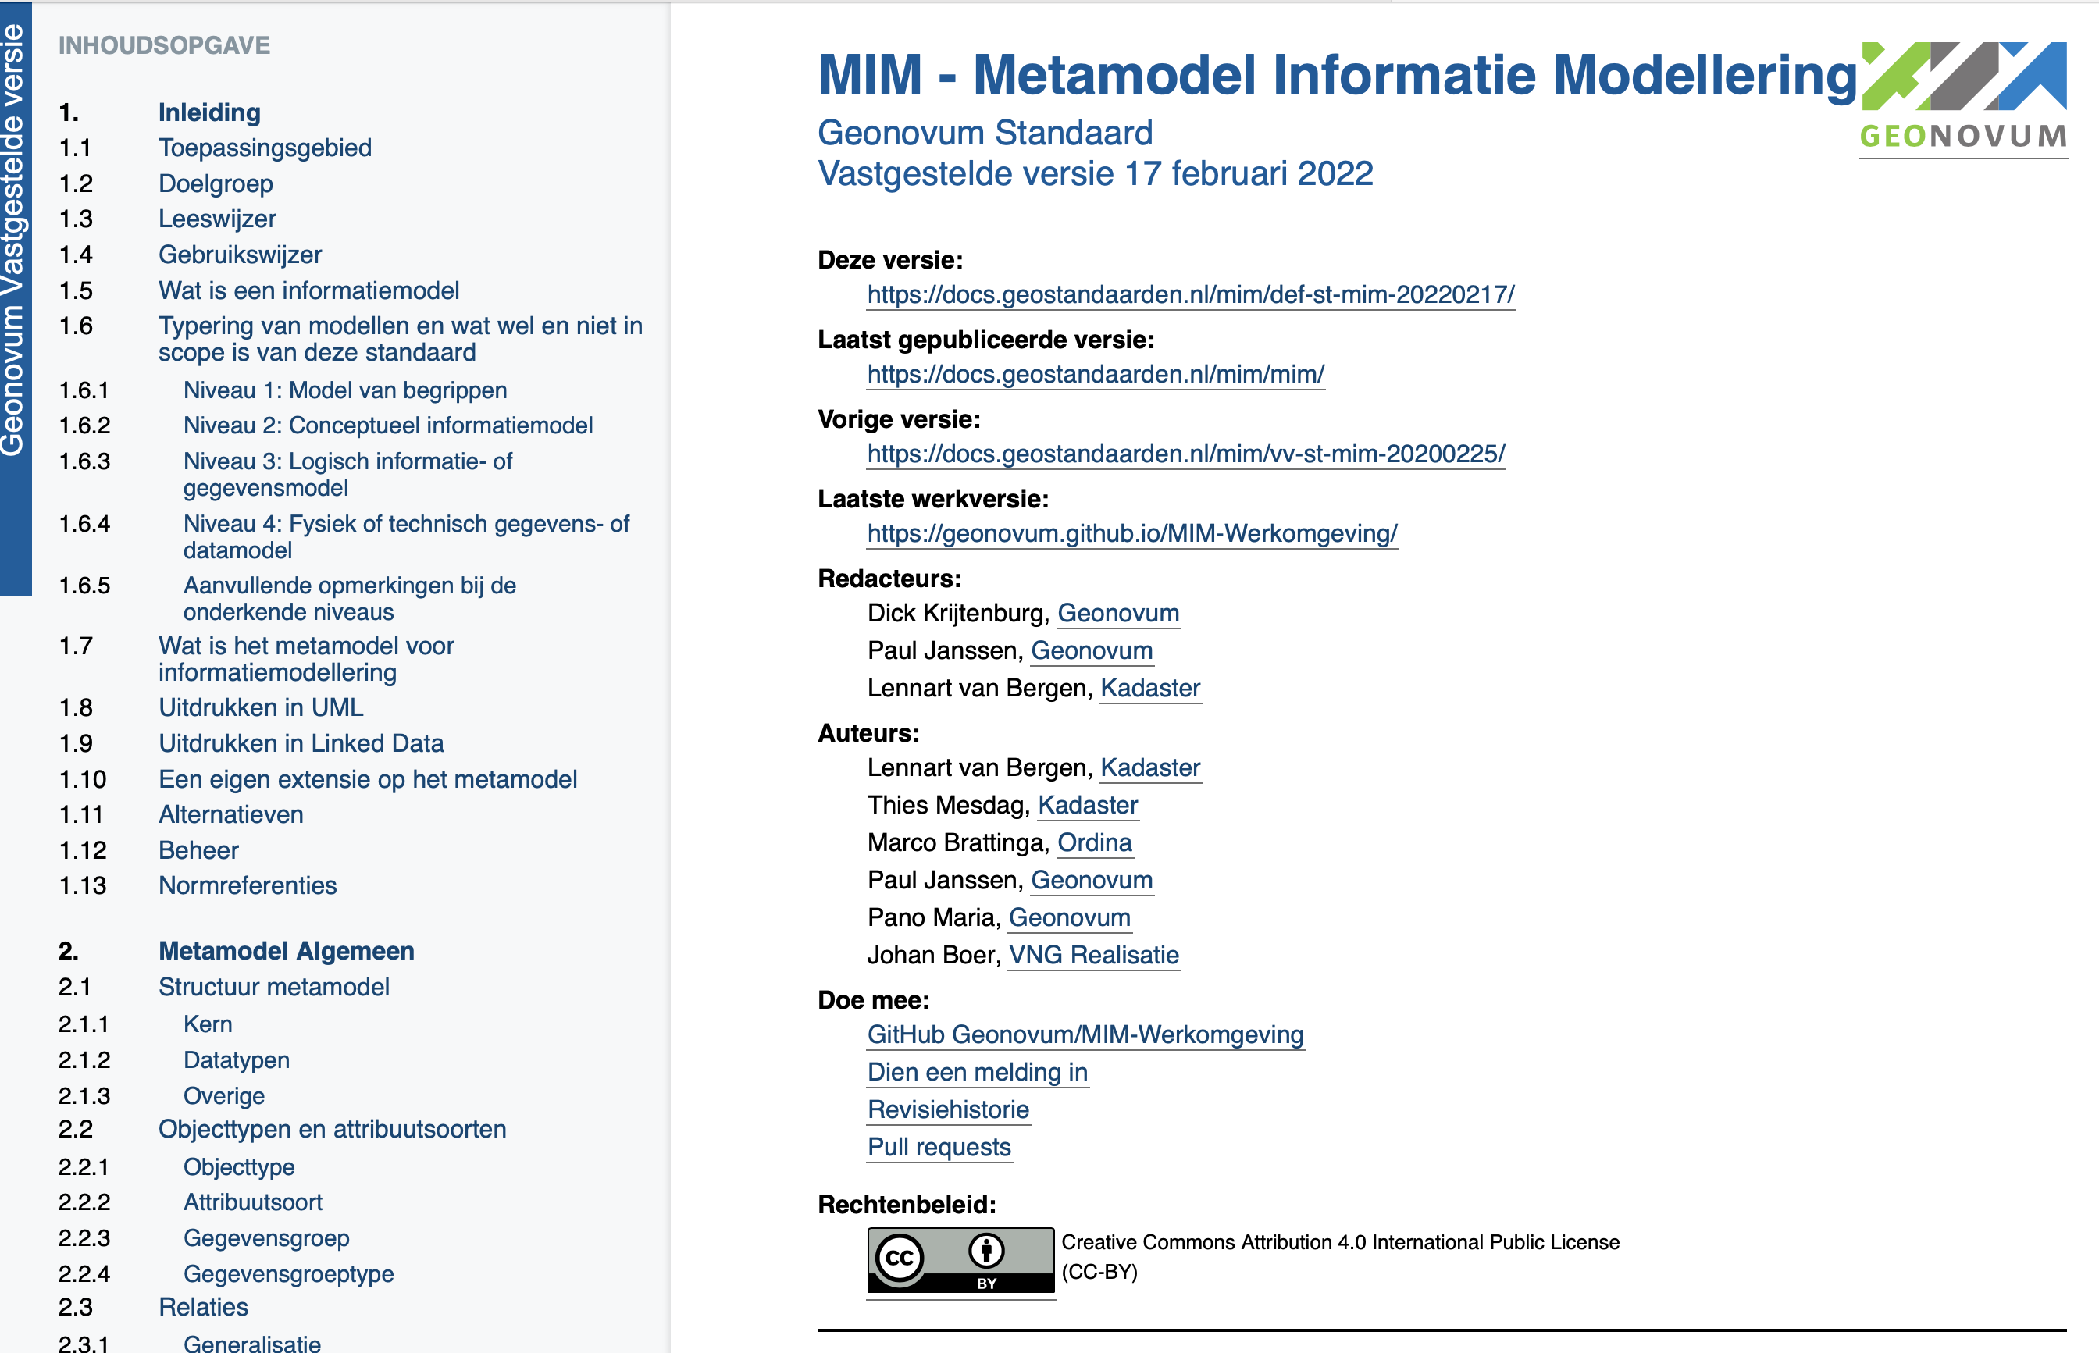
MIM Linked Data

Slide 2
MIM Linked Data
Agenda
Linked Data
introductie
MIM niveaus
MIM representaties
UML vs RDF
MIM-LD toolset
MIM-RDF & Linked Data
MIM-LD
case case
Om te onthouden

Slide 3


Linked Data introductie
“Paul works for Geonovum”
subject
predicate
object
onderwerp
gezegde
(lijdend) voorwerp

Slide 4
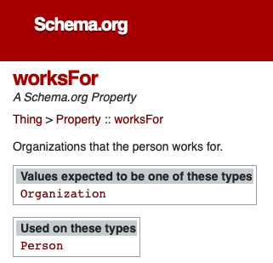
Linked Data introductie
Paul
worksFor
Geonovum
@prefix schema: <http://schema.org/>.
@prefix ex: <http://example.org/>.
ex:Paul schema:worksFor ex:Geonovum.

Slide 5
Linked Data introductie
Paul
worksFor
Geonovum
is a
Person
@prefix schema: <http://schema.org/>.
@prefix ex: <http://example.org/>.
ex:Paul schema:worksFor ex:Geonovum.
ex:Paul a schema:Person.

Slide 6
Linked Data introductie
Paul
worksFor
Geonovum
is a
is an
Person
Organization
@prefix schema: <http://schema.org/>.
@prefix ex: <http://example.org/>.
ex:Paul schema:worksFor ex:Geonovum.
ex:Paul a schema:Person.
ex:Geonovum a schema:Organization.

Slide 7
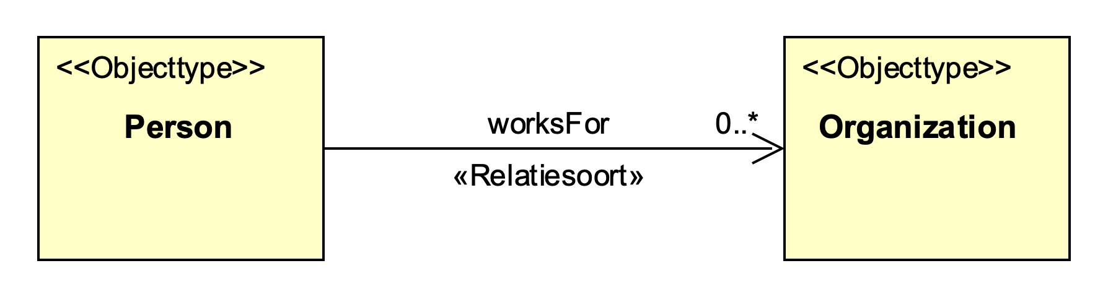
Linked Data introductie
Paul
worksFor
Geonovum
is a
is an
Person
Organization
@prefix schema: <http://schema.org/>.
@prefix ex: <http://example.org/>.
ex:Paul schema:worksFor ex:Geonovum.
ex:Paul a schema:Person.
ex:Geonovum a schema:Organization.

Slide 8


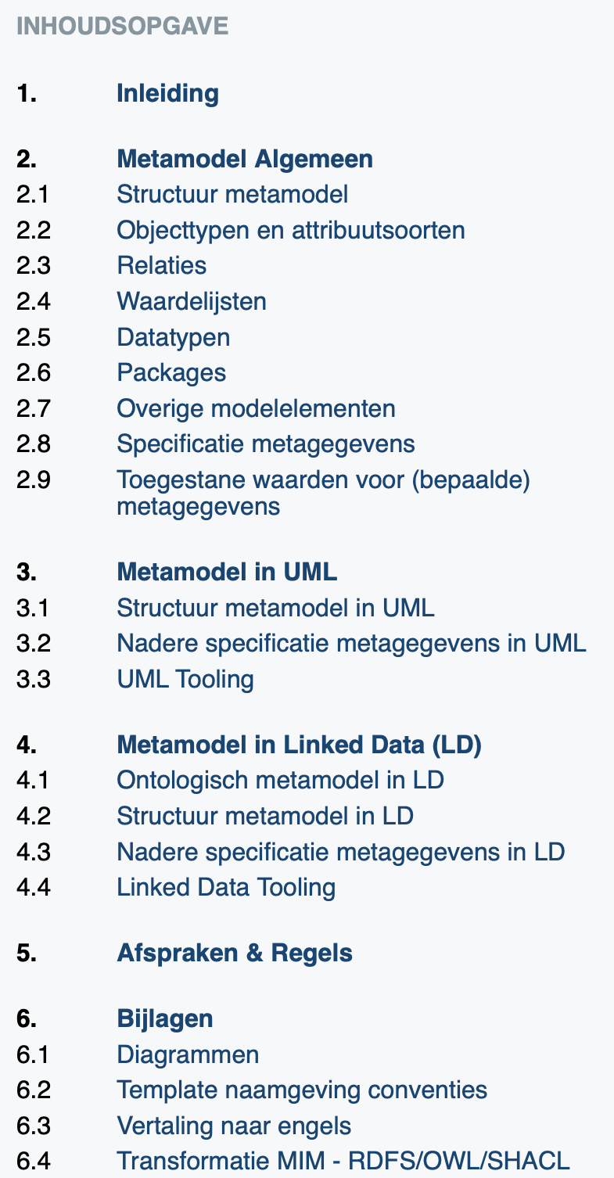








MIM representaties
MIM metamodel
representatie van
representatie van
RDF MIM
model
UML MIM
profiel
Geen gestandaardiseerde diagramweergave;
Diverse gestandaardiseerde serialisatie (RDF/XML, JSON-LD, Turtle, …)
Gestandaardiseerde diagramweergave;
Geen gestandaardiseerde serialisatie.

Slide 9
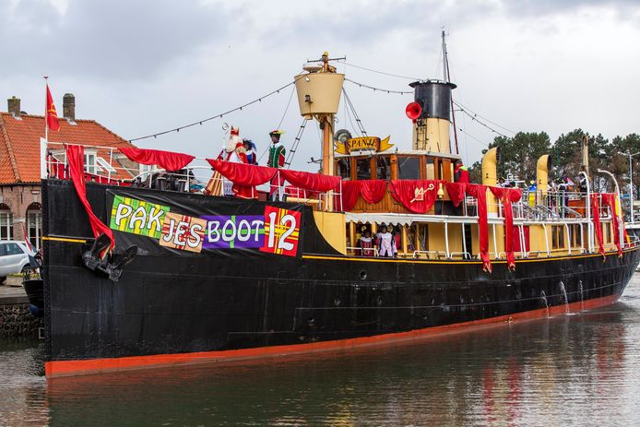
MIM representaties
MIM metamodel
representatie van
representatie van
RDF MIM
model
UML MIM
profiel
{
“@id” : “urn:uuid:1234”,
“@type” : “ex:Schip”;
“ex:naam” : “Pakjesboot 12”;
}
JSON-LD
<urn:uuid:1234> a ex:Schip;
ex:naam “Pakjesboot 12”
.
turtle
<rdf:RDF>
<ex:Schip rdf:about=“urn:uuid:1234”>
<ex:naam>Pakjesboot 12</vb:naam>
</ex:Schip>
</rdf:RDF>
<data>
<ex:Schip id=“urn:uuid:1234”>
<ex:naam>Pakjesboot 12</vb:naam>
</ex:Schip>
</data>
<rdf:RDF>
<ex:Schip rdf:about=“urn:uuid:1234”>
<ex:naam>Pakjesboot 12</vb:naam>
</ex:Schip>
</rdf:RDF>
RDF/XML
XML
RDF/XML

Slide 10
MIM representaties
MIM metamodel
representatie van
representatie van
RDF MIM
model
UML MIM
profiel
{
“@id” : “urn:uuid:1234”,
“@type” : “ex:Schip”;
“ex:naam” : “Pakjesboot 12”;
}
taaltransformatie
niveau transformatie
JSON-LD
OWL
ontologie
XSD
schema
</>
<urn:uuid:1234> a ex:Schip;
ex:naam “Pakjesboot 12”
.
turtle
<rdf:RDF>
<ex:Schip rdf:about=“urn:uuid:1234”>
<ex:naam>Pakjesboot 12</vb:naam>
</ex:Schip>
</rdf:RDF>
<data>
<ex:Schip id=“urn:uuid:1234”>
<ex:naam>Pakjesboot 12</vb:naam>
</ex:Schip>
</data>
<rdf:RDF>
<ex:Schip rdf:about=“urn:uuid:1234”>
<ex:naam>Pakjesboot 12</vb:naam>
</ex:Schip>
</rdf:RDF>
RDF/XML
XML
RDF/XML

Slide 11
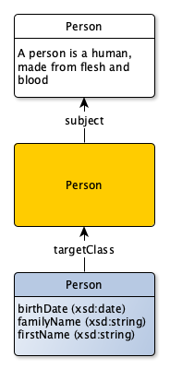


Beschouwingsniveaus
skos:Concept
Model van begrippen
waar hebben we het over?
Niveau 1
model van
owl:Class
Conceptueel informatiemodel
Welke informatie is relevant?
Niveau 2
werkelijkheid
sh:Shape
Logisch gegevensmodel
Hoe worden de gegevens gebruikt?
Niveau 3
model van
Technisch datamodel
Hoe op te slaan of uit te wisselen?
administratie
Niveau 4
uitwisseling
gebruik

Slide 12
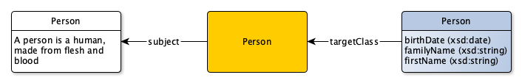
UML vs LD
@prefix rdfs: <http://www.w3.org/2000/01/rdf-schema#>.
@prefix skos: <http://www.w3.org/2004/02/skos/core#>.
@prefix owl: <http://www.w3.org/2002/07/owl#>.
@prefix sh: <http://www.w3.org/ns/shacl#>.
@prefix xsd: <http://www.w3.org/2001/XMLSchema#>.
@prefix exc: <http://example.org/concept/>.
@prefix exo: <http://example.org/ontology#>.
@prefix exs: <http://example.org/shapegraph#>.
exc:Person a skos:Concept;
skos:prefLabel “Person”@en;
skos:definition “A person is a human made, from flesh and blood”@en;
.
exo:Person a owl:Class;
rdfs:label “Person”@en;
dct:subject exc:Person;
.
exs:Person a sh:NodeShape;
sh:targetClass exo:Person;
sh:name “Person”;
sh:property [
sh:path exo:birthDate;
sh:datatype xsd:date;
];
sh:property [
sh:path exo:familyName;
sh:datatype xsd:string;
];
sh:property [
sh:path exo:firstName;
sh:datatype xsd:string;
];
.
UML has no canonical serialization (despite XMI)
Linked Data has no canonical notation.

Slide 13
UML vs LD
@prefix rdfs: <http://www.w3.org/2000/01/rdf-schema#>.
@prefix skos: <http://www.w3.org/2004/02/skos/core#>.
@prefix owl: <http://www.w3.org/2002/07/owl#>.
@prefix sh: <http://www.w3.org/ns/shacl#>.
@prefix xsd: <http://www.w3.org/2001/XMLSchema#>.
@prefix exc: <http://example.org/concept/>.
@prefix exo: <http://example.org/ontology#>.
@prefix exs: <http://example.org/shapegraph#>.
exc:Person a skos:Concept;
skos:prefLabel “Person”@en;
skos:definition “A person is a human made, from flesh and blood”@en;
.
exo:Person a owl:Class;
rdfs:label “Person”@en;
dct:subject exc:Person;
.
exs:Person a sh:NodeShape;
sh:targetClass exo:Person;
sh:name “Person”;
sh:property [
sh:path exo:birthDate;
sh:datatype xsd:date;
];
sh:property [
sh:path exo:familyName;
sh:datatype xsd:string;
];
sh:property [
sh:path exo:firstName;
sh:datatype xsd:string;
];
.
UML has no canonical serialization (despite XMI)
Linked Data has no canonical notation.

Slide 14
UML vs LD
@prefix rdfs: <http://www.w3.org/2000/01/rdf-schema#>.
@prefix skos: <http://www.w3.org/2004/02/skos/core#>.
@prefix owl: <http://www.w3.org/2002/07/owl#>.
@prefix sh: <http://www.w3.org/ns/shacl#>.
@prefix xsd: <http://www.w3.org/2001/XMLSchema#>.
@prefix exc: <http://example.org/concept/>.
@prefix exo: <http://example.org/ontology#>.
@prefix exs: <http://example.org/shapegraph#>.
exc:Person a skos:Concept;
skos:prefLabel “Person”@en;
skos:definition “A person is a human made, from flesh and blood”@en;
.
exo:Person a owl:Class;
rdfs:label “Person”@en;
dct:subject exc:Person;
.
exs:Person a sh:NodeShape;
sh:targetClass exo:Person;
sh:name “Person”;
sh:property [
sh:path exo:birthDate;
sh:datatype xsd:date;
];
sh:property [
sh:path exo:familyName;
sh:datatype xsd:string;
];
sh:property [
sh:path exo:firstName;
sh:datatype xsd:string;
];
.
UML has no canonical serialization (despite XMI)
Linked Data has no canonical notation.

Slide 15
UML vs LD
@prefix rdfs: <http://www.w3.org/2000/01/rdf-schema#>.
@prefix skos: <http://www.w3.org/2004/02/skos/core#>.
@prefix owl: <http://www.w3.org/2002/07/owl#>.
@prefix sh: <http://www.w3.org/ns/shacl#>.
@prefix xsd: <http://www.w3.org/2001/XMLSchema#>.
@prefix exc: <http://example.org/concept/>.
@prefix exo: <http://example.org/ontology#>.
@prefix exs: <http://example.org/shapegraph#>.
exc:Person a skos:Concept;
skos:prefLabel “Person”@en;
skos:definition “A person is a human made, from fle
.
exo:Person a owl:Class;
rdfs:label “Person”@en;
dct:subject exc:Person;
.
exs:Person a sh:NodeShape;
sh:targetClass exo:Person;
sh:name “Person”;
sh:property [
sh:path exo:birthDate;
sh:datatype xsd:date;
];
sh:property [
sh:path exo:familyName;
sh:datatype xsd:string;
];
sh:property [
sh:path exo:firstName;
sh:datatype xsd:string;
];
.
UML has no canonical serialization (despite XMI)
Linked Data has no canonical notation.

Slide 16
UML vs LD
@prefix rdfs: <http://www.w3.org/2000/01/rdf-schema#>.
@prefix skos: <http://www.w3.org/2004/02/skos/core#>.
@prefix owl: <http://www.w3.org/2002/07/owl#>.
@prefix sh: <http://www.w3.org/ns/shacl#>.
@prefix xsd: <http://www.w3.org/2001/XMLSchema#>.
@prefix exc: <http://example.org/concept/>.
@prefix exo: <http://example.org/ontology#>.
@prefix exs: <http://example.org/shapegraph#>.
exc:Person a skos:Concept;
skos:prefLabel “Person”@en;
skos:definition “A person is a human made, from flesh and blood”@en;
.
exo:Person a owl:Class;
rdfs:label “Person”@en;
dct:subject exc:Person;
.
exs:Person a sh:NodeShape;
sh:targetClass exo:Person;
sh:name “Person”;
sh:property [
sh:path exo:birthDate;
sh:datatype xsd:date;
];
sh:property [
sh:path exo:familyName;
sh:datatype xsd:string;
];
sh:property [
sh:path exo:firstName;
sh:datatype xsd:string;
];
.
UML has no canonical serialization (despite XMI)
Linked Data has no canonical notation.

Slide 17
UML vs LD
@prefix xsd: <http://www.w3.org/2001/XMLSchema#>.
@prefix exc: <http://example.org/concept/>.
@prefix exo: <http://example.org/ontology#>.
@prefix exs: <http://example.org/shapegraph#>.
exc:Person a skos:Concept;
skos:prefLabel “Person”@en;
skos:definition “A person is a human made, from flesh and blood”@en;
.
exo:Person a owl:Class;
rdfs:label “Person”@en;
dct:subject exc:Person;
.
exs:Person a sh:NodeShape;
sh:targetClass exo:Person;
sh:name “Person”;
sh:property [
sh:path exo:birthDate;
sh:datatype xsd:date;
];
sh:property [
sh:path exo:familyName;
sh:datatype xsd:string;
];
sh:property [
sh:path exo:firstName;
sh:datatype xsd:string;
];
.
UML has no canonical serialization (despite XMI)
Linked Data has no canonical notation.

Slide 18
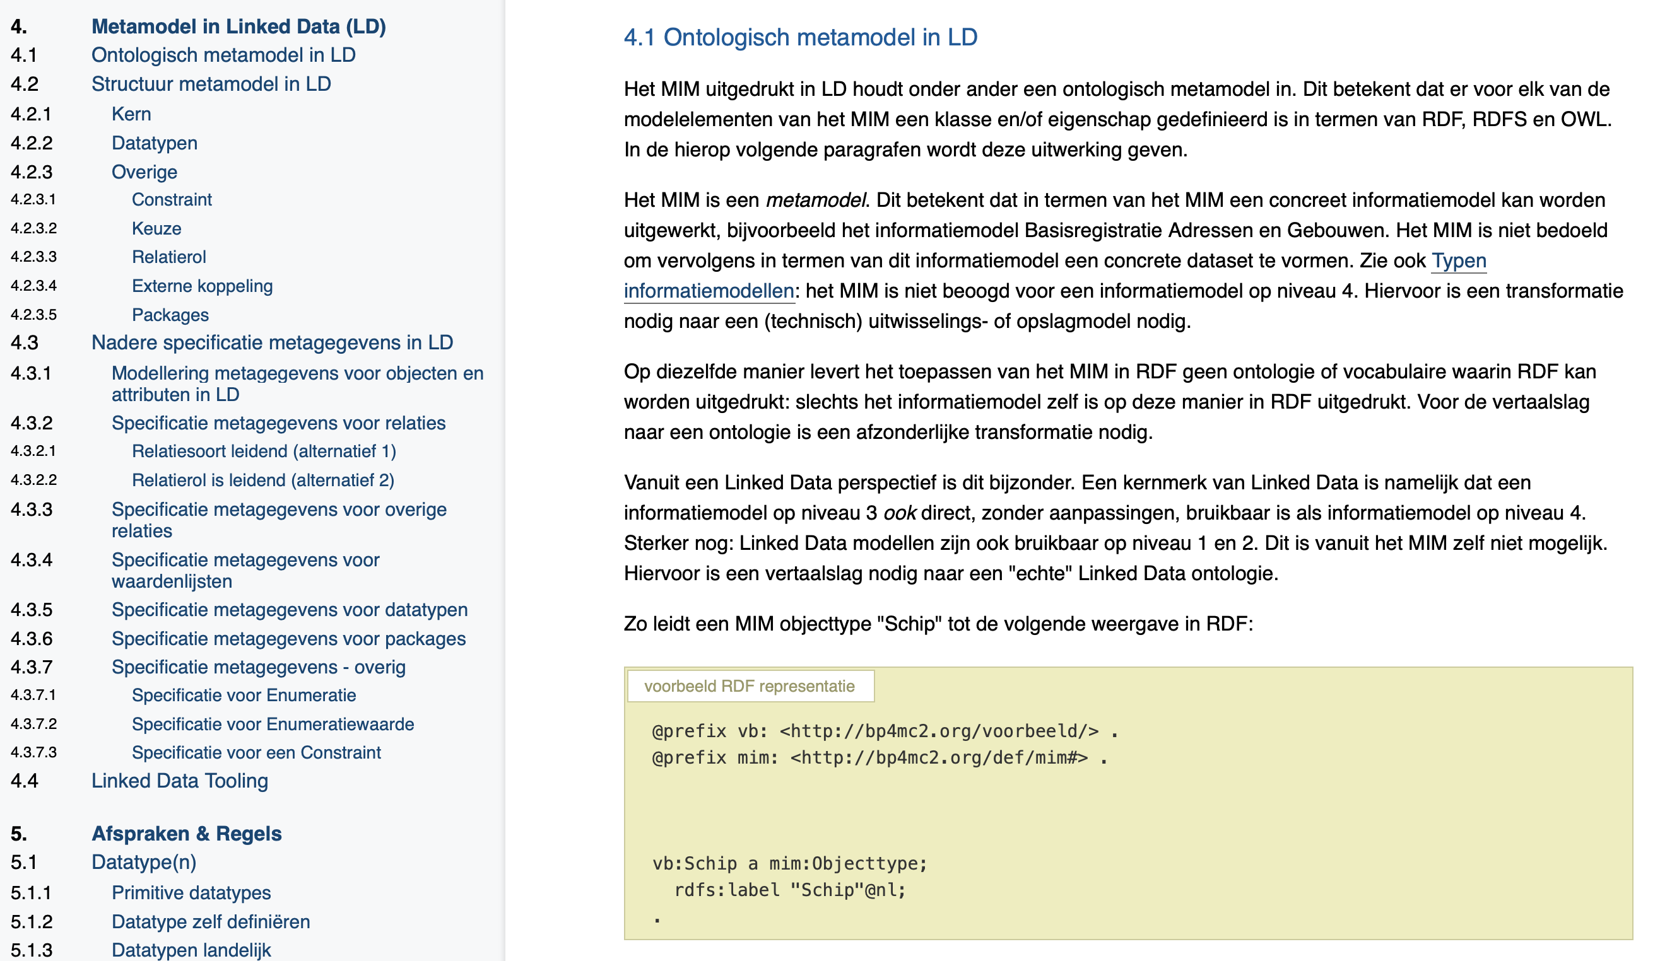
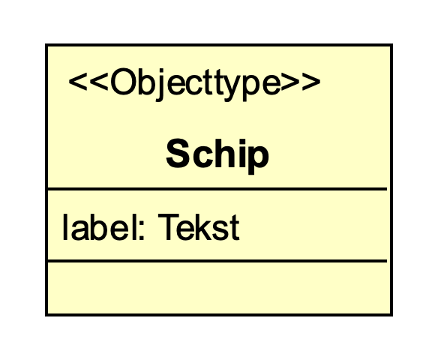
MIM in Linked Data

Slide 19
MIM in Linked Data
@prefix exmim: <http://example.org/mim/>.
@prefix mim: <http://bp4mc2.org/def/mim#>.
@prefix xsd: <http://www.w3.org/2001/XMLSchema#>.
@prefix owl: <http://www.w3.org/2002/07/owl#>.
exmim:Schip a mim:Objecttype;
mim:naam "Schip";
mim:attribuut exmim:label
.
exmim:label a mim:Attribuutsoort;
mim:naam "label";
mim:type exmim:Tekst;
mim:kardinaliteit "1";
.
exmim:Tekst a mim:PrimitiefDatatype;
mim:naam "Tekst";
owl:sameAs xsd:string;
.
=

Slide 20
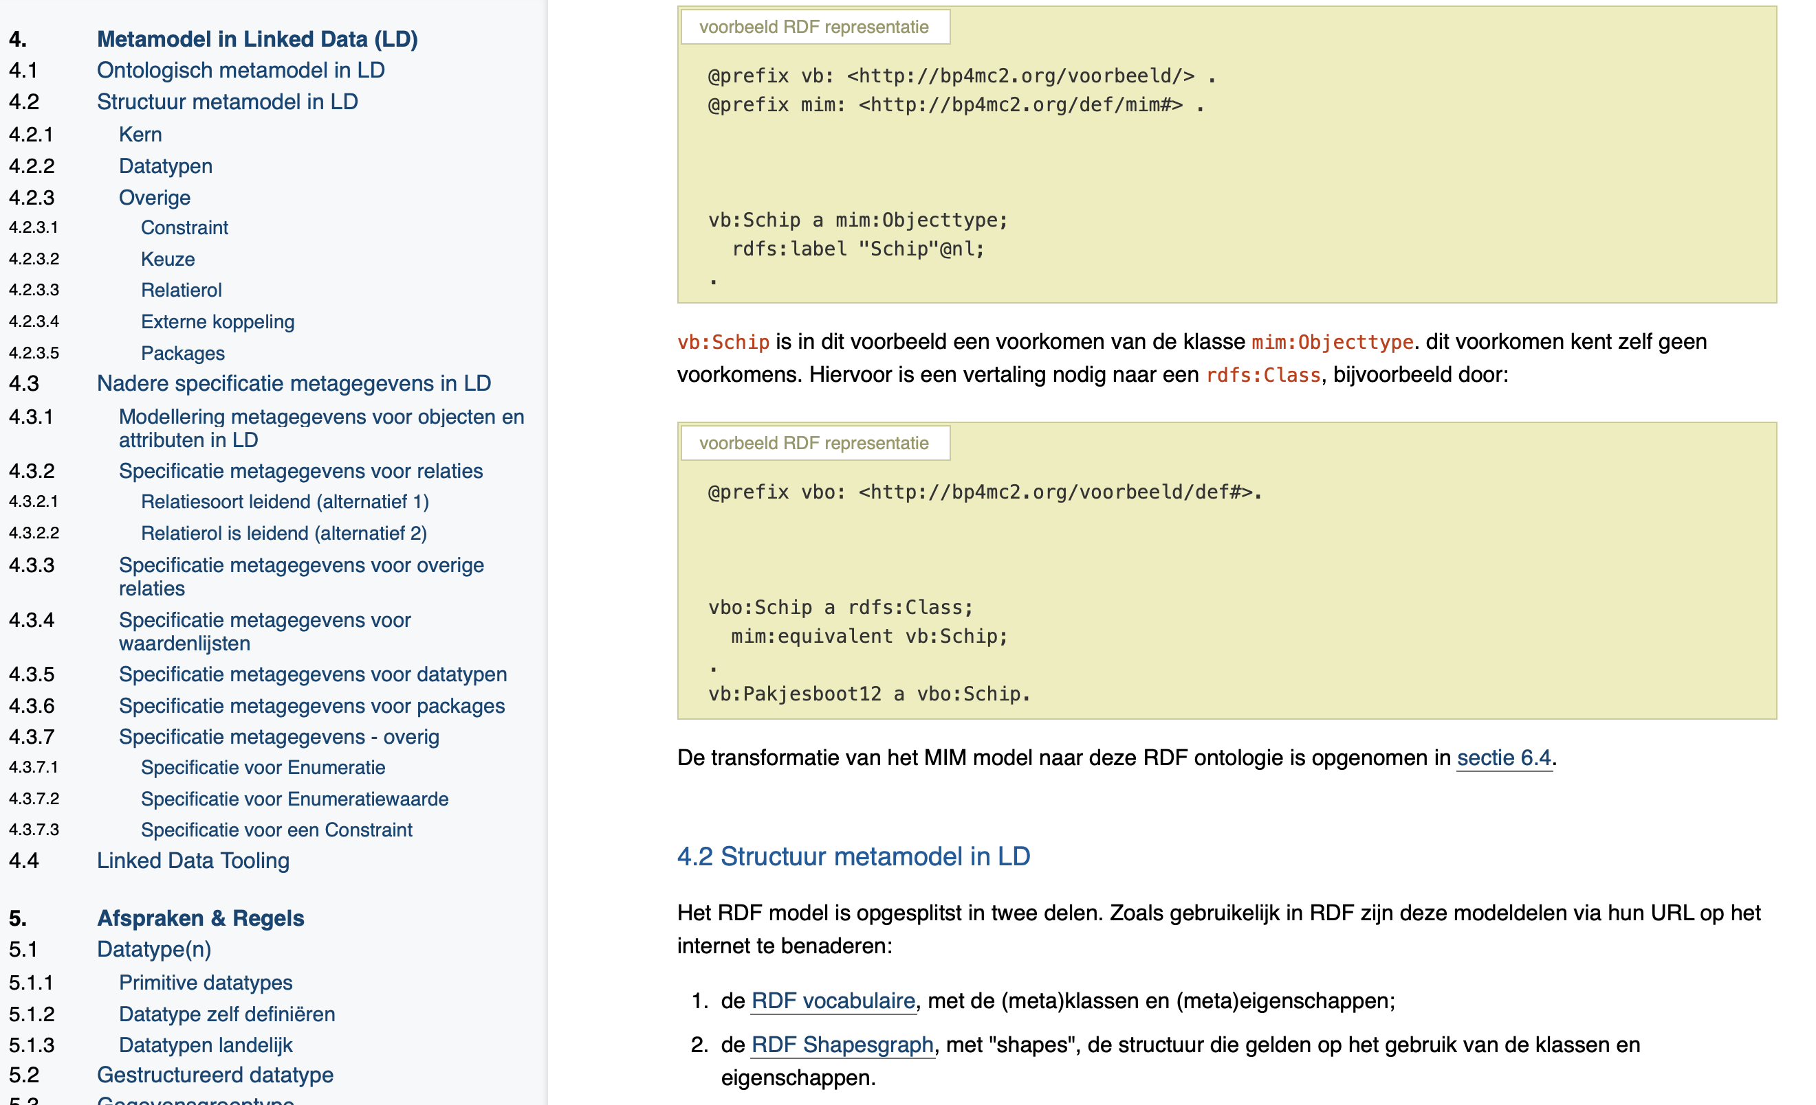
MIM in Linked Data
MIM
RDFS/OWL/SHACL
Data

Slide 21

Use case: e-commerce

Slide 22

Vindbaar op het web?

Slide 23
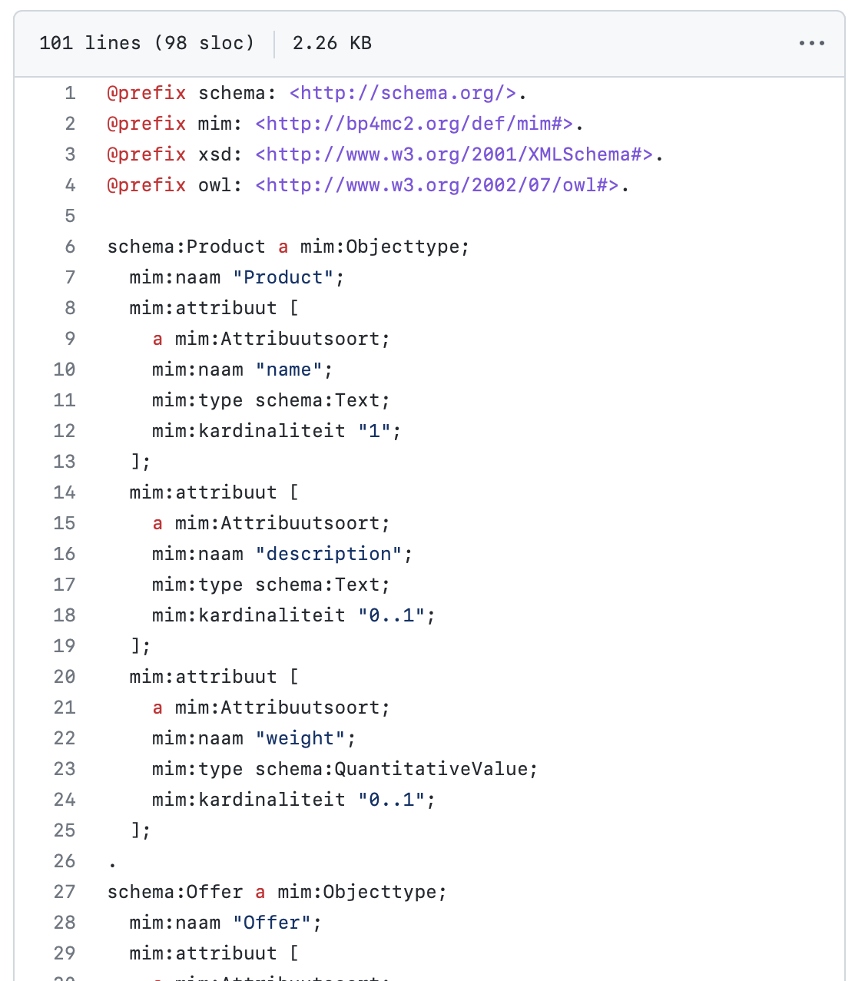
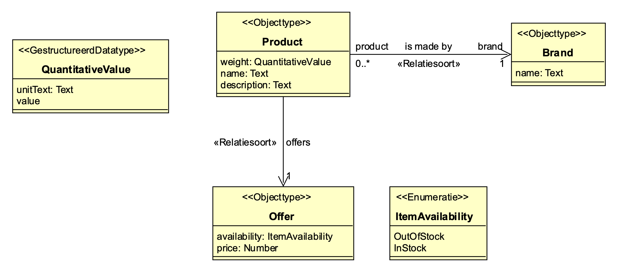
Gestructureerde data!
RDF MIM
model

Slide 24
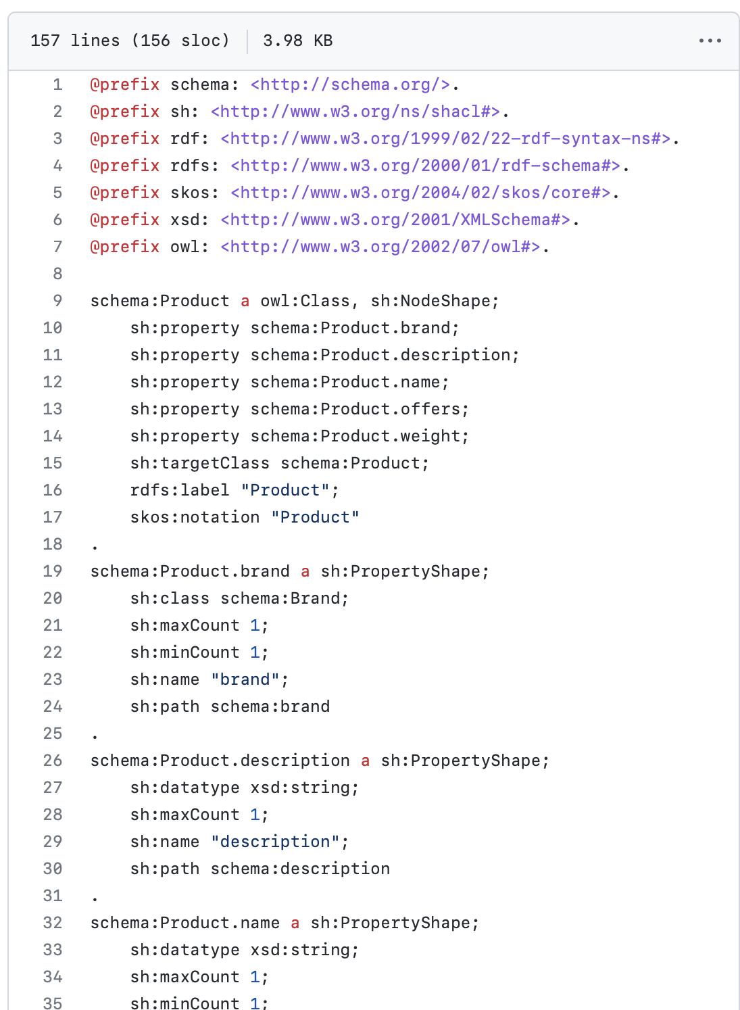
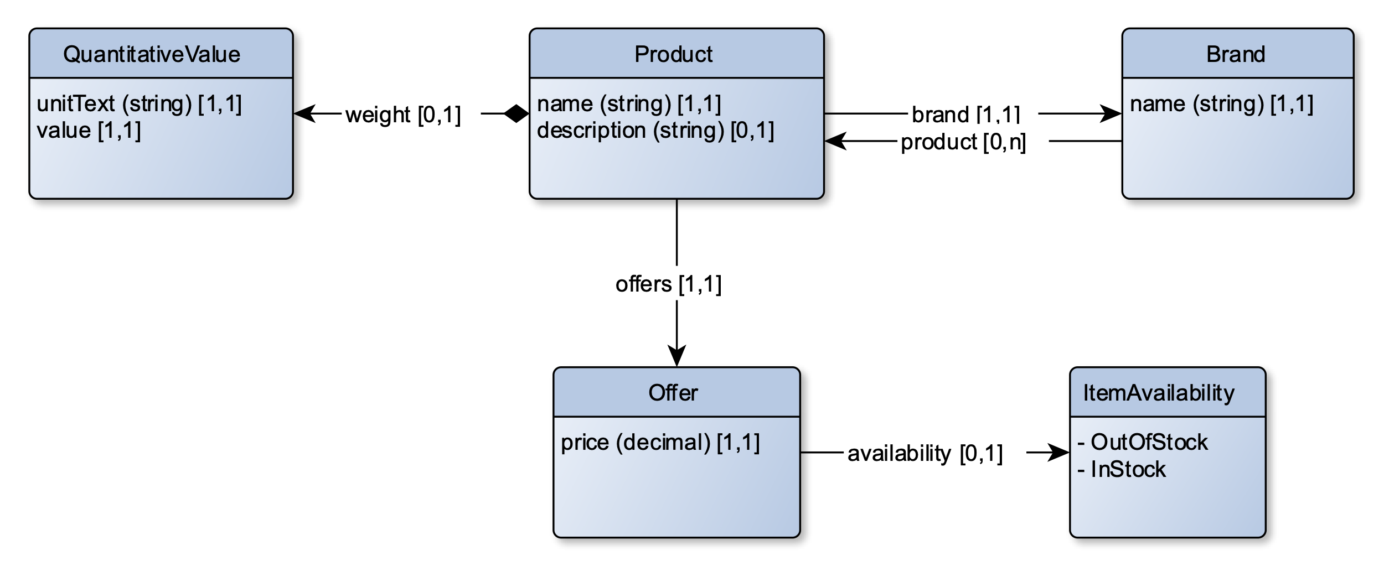
Google moet het wel snappen
RDF MIM
model
taaltransformatie
OWL
ontologie

Slide 25
Snapt google het?

Slide 26
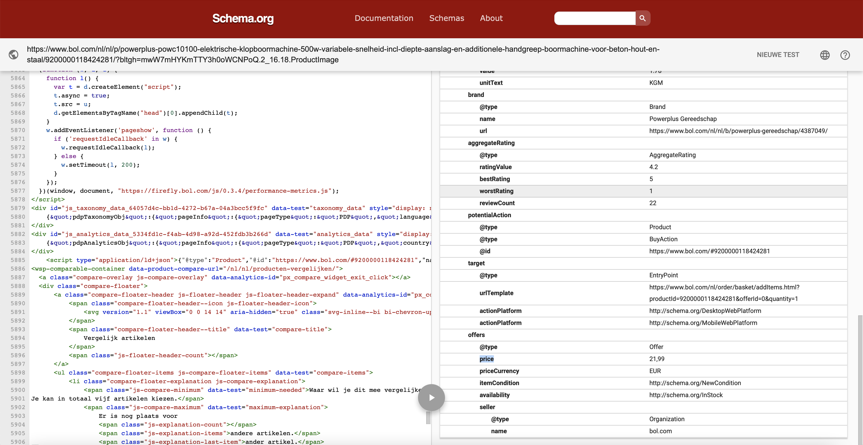
Google snapt het!

Slide 27



Ondersteuning
.EAP
.EAPX
van IM in tool
naar MIM-RDF
van IM in tool
naar MIM-XML
</>
van MIM-XML
naar MIM-RDF
.TTL
.JSON
.XML
.XML
.TTL
.JSON
.XML
van MIM-RDF naar
RDF IM (ontologie)
van IM in tool
naar XSD schema
van MIM-RDF
naar MIM-XML
OWL
van RDF ontologie
naar MIM-RDF
van MIM-XML
naar XSD schema
van MIM-RDF
naar RDF schema
</>
.TTL
.JSON
.XML
Beschikbaar in MIM toolset voor LD
.XSD

Slide 28
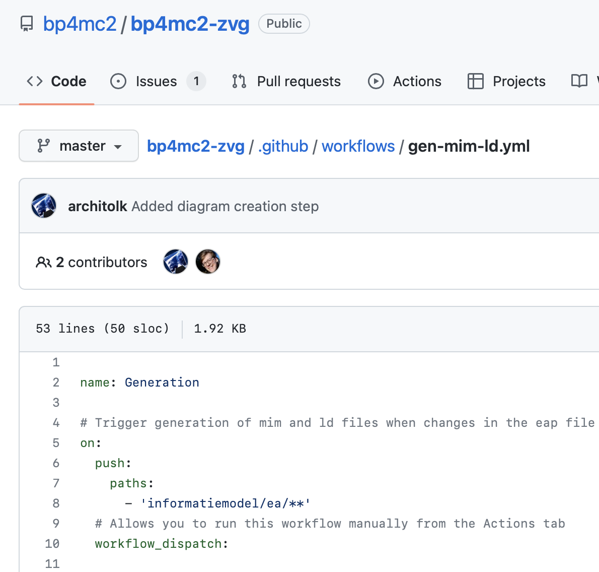


Ondersteuning
ea2rdf Omzetten van EA model naar mim-ld
mim2graphml Genereren diagrammen obv mim-ld
mim2onto Transformatie MIM-LD naar OWL/SHACL
mimtools Validatie van mim-ld modellen

Slide 29
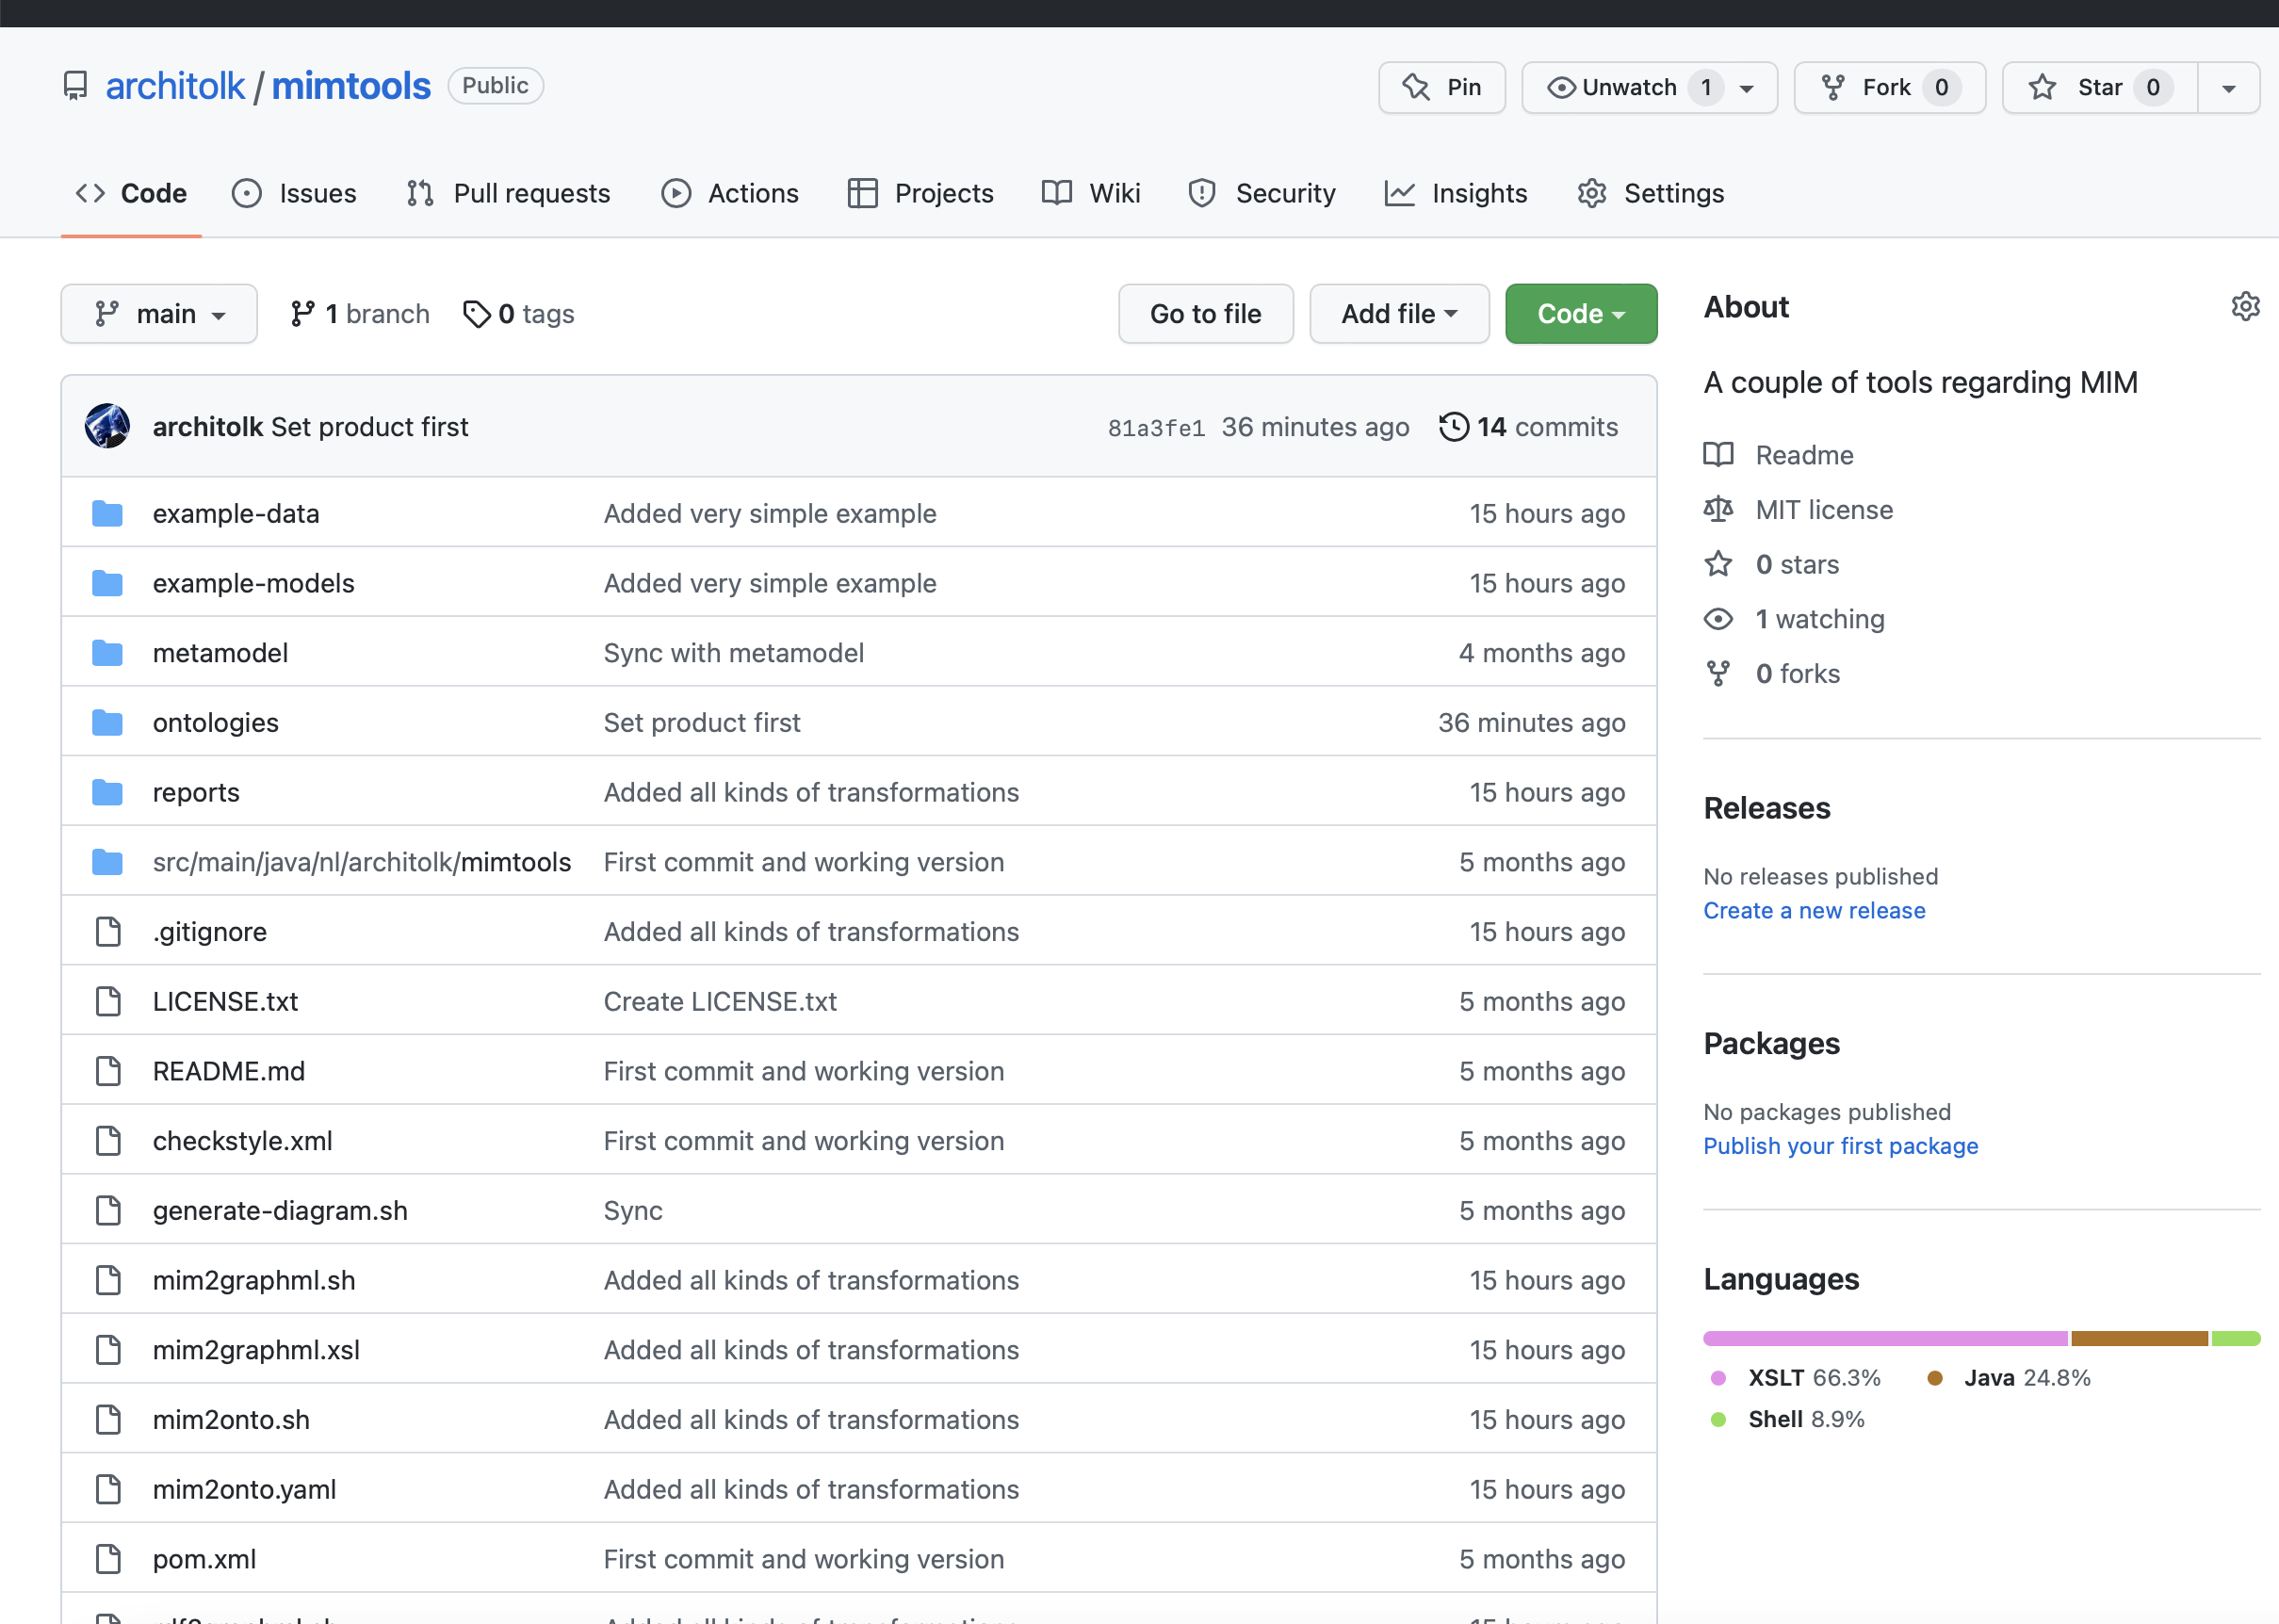
Ondersteuning
MIM toolset
voor Linked Data
https://github.com/architolk/mimtools

Slide 30
Om te onthouden
Linked Data is niet eng Er zijn standard afspraken en een toolset beschikbaar zodat… ...als je MIM-modellen maakt, je deze automatisch kunt omzetten naar Linked Data
MIM is niet eng Het is mogelijk om MIM modellen te maken zonder UML tooling en… …je kunt voldoen aan MIM door het maken van (de juiste) Linked Data modellen.
Je kunt kiezen! …voor de UML toolstack (Enterprise Architect, MIM-profiel, Imvertor), of… …de RDF toolstack (MIM toolset voor LD, yEd, Git, your-favourite-editor)

